Slide 1
Chapter 2.
Software & OS Security

Slide 2
Contents
Software Security
Software vulnerabilies
Most common vulnerabilities
Vulnerable program
Buffer overflow
Defense against buffer overflow
OS Security
OS Security Functions
OS and Resource Protection
OS Hardening

Slide 3
Software Vulnerabilities
In computer security, a vulnerability is a weakness which can be exploited by a threat actor, such as an attacker, to perform unauthorized actions within a computer system.
Vulnerability: A weakness in the security system, e.g., in policy, design, or implementation, that might be exploited to cause loss or harm.

Slide 4
Software Vulnerabilities
The severity of software vulnerabilities advances at an exponential rate. Of course, all systems include vulnerabilities. The thing is whether or not they’re exploited to cause damage.
Examples:
Software: does not check input data → let in malicious code
Database or Wifi router left configured with known default passwords
Policy: not restrict enough

Slide 5
Software Vulnerabilities
Software vulnerabilities are defined by three factors. These are:
Existence – The existence of a vulnerability in the software.
Access – The possibility that hackers gain access to the vulnerability.
Exploit – The capability of the hacker to take advantage of that vulnerability via tools or with certain techniques.

Slide 6
What cause vulnerabilities
Complexity:
Complex systems increase the probability of a flaw, misconfiguration or unintended access.
Familiarity:
Common code, software, operating systems and hardware increase the probability that an attacker can find or has information about known vulnerabilities.
Connectivity:
The more connected a device is the higher the chance of a vulnerability.
Poor password management:
Weak passwords can be broken with brute force and reusing passwords can result in one data breach becoming many.

Slide 7
What cause vulnerabilities (cont.)
Operating system flaws:
Like any software, operating systems can have flaws. Operating systems that are insecure by default and give all users full access can allow viruses and malware to execute commands.
Internet usage:
The Internet is full of spyware and adware that can be installed automatically on computers.
Software bugs:
Programmers can accidentally or deliberately leave an exploitable bug in software.
Unchecked user input:
If your website or software assume all input is safe it may execute unintended SQL commands.
People:
The biggest vulnerability in any organization is the human at the end of the system. Social engineering is the biggest threat to the majority of organizations.

Slide 8
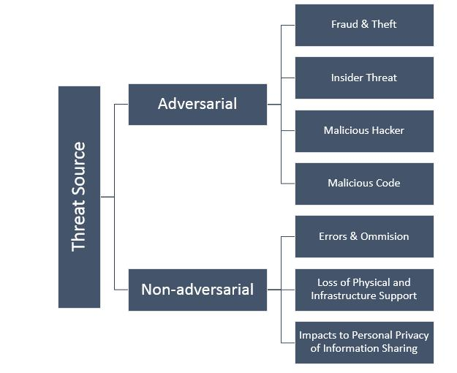
Software Vulnerabilities
Threats: a set of circumstances that has the potential to cause loss or harm.
Threats to computerized information systems include hardware and software failure; user errors; physical disasters such as fire or power failure; theft of data, services, and equipment; unauthorized use of data; and telecommunications disruptions.

Slide 9
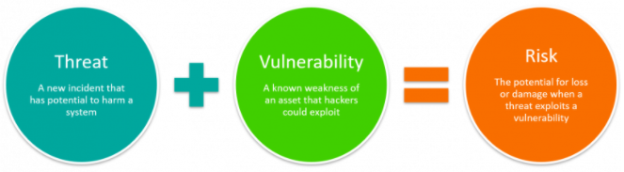
Control Vulnerability
Control: an action, device, policy, procedure, or technique that removes or reduces a vulnerability
A threat is blocked by control of vulnerability

Slide 10
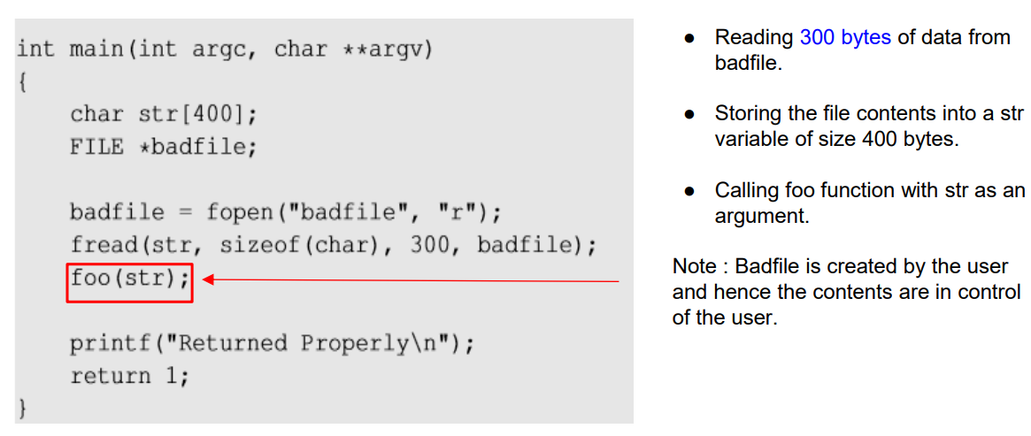
Vulnerable Program

Slide 11
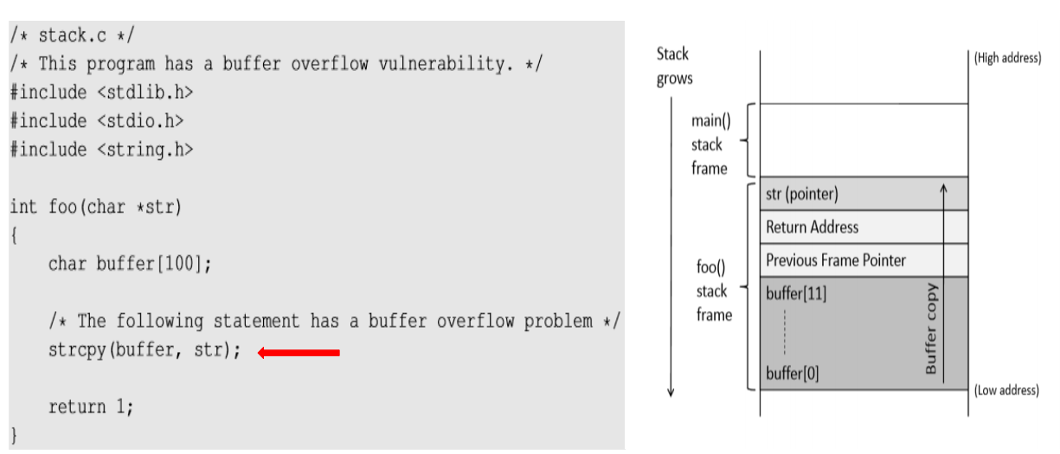
Vulnerable Program

Slide 12
Most Common Vulnerabilities
Buffer overflow
SQL Injection
Missing or broken authentication/authorization
Issues with Web services and APIs
Failure to protect sensitive data
….

Slide 13
Questions
Vulnerability Scanning Tools?
Acunetix
Nexpose
Retina
….

Slide 14
Buffer overflow
Defined in the NIST
“A condition at an interface under which more input can be placed into a buffer or data-holding area than the capacity allocated, overwriting other information. Attackers exploit such a condition to crash a system or to insert specially crafted code that allows them to gain control of the system”

Slide 15
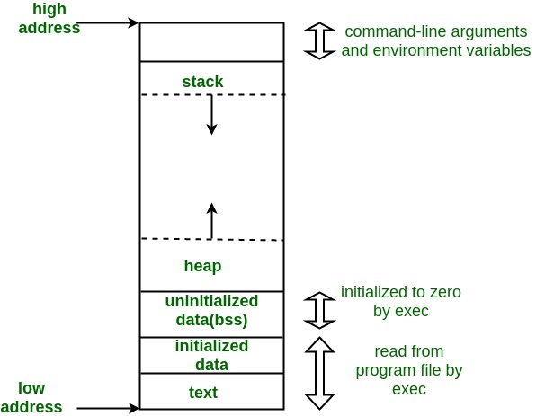
Program memory layout
Is used for storing local variables defined inside functions, as well as return address, arguments
Is used to provide space for dynamic memory allocation
Is used to provide space for dynamic memory allocation
Store unintialized static/global variables
Stores inintialized static/global variables
Store the executable code of the program

Slide 16
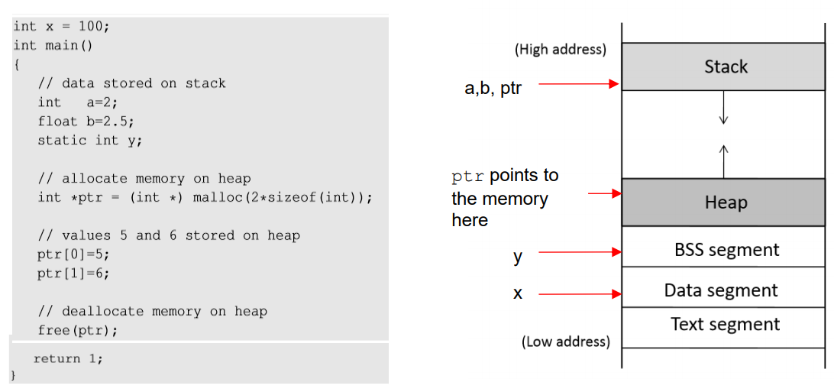
Program Memory Stack

Slide 17
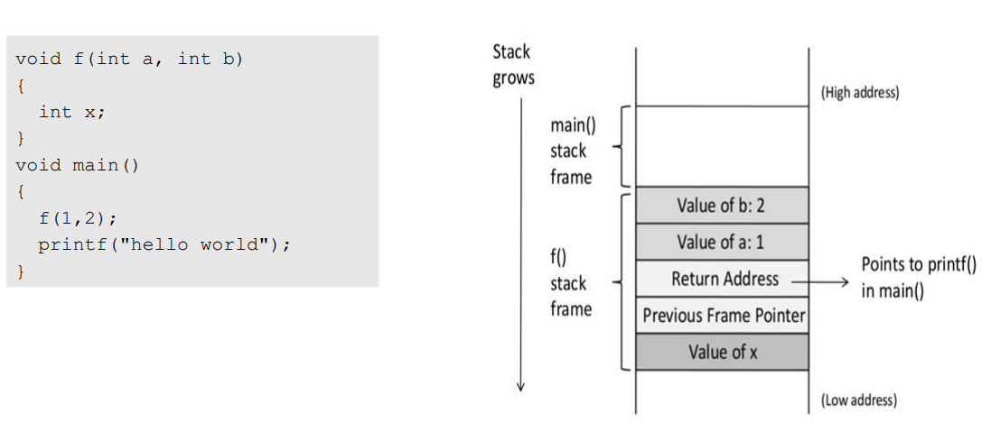
Function Call Stack

Slide 18
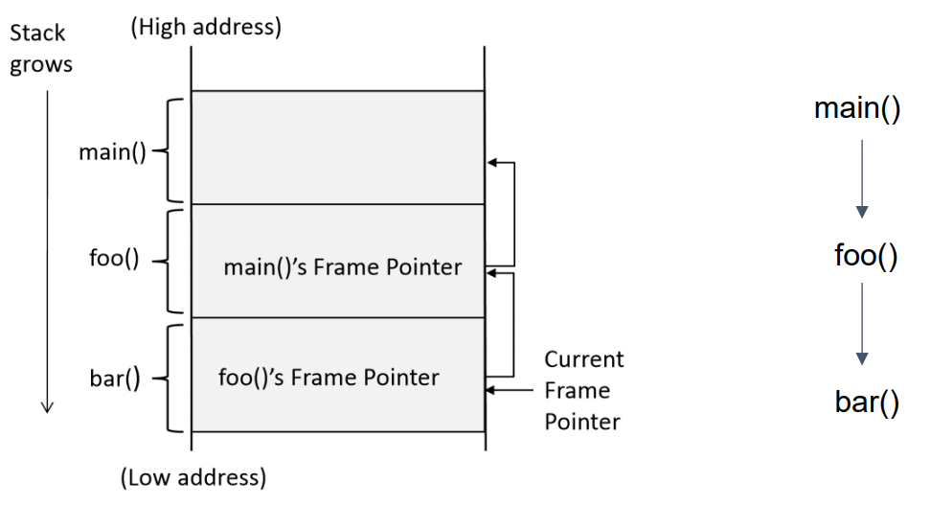
Stack Layout for Function Call Chain

Slide 19
Stack Buffer-Oveflow attack
Memory copying is quite common in programs, where data from one place (source) need to be copied to another place (destination). Before copying, a program needs to allocate memory space for the destination.
Sometimes, programmers may make mistaken and fail to allocate sufficient amount of memory for the destination, so more data will be copied to the destination than the amount of allocated space. This will result in an overflow.

Slide 20
Some examples - What is Buffer Overflow?
char buff[10]
‘buff’ represents an array of 10 bytes where buff[0] is the left boundary and buff[9] is the right boundary of the buffer.
we declared an array of size 10 bytes. Please note that index 0 to index 9 can used to refer these 10 bytes of buffer. But, in the next line, we index 10 was used to store the value ‘a’. This is the point where buffer overrun happens because data gets written beyond the right boundary of the buffer.
char buff[10];
buff[10] = 'a';

Slide 21
Some examples
char buff[10] = {0};
strcpy(buff, "This String Will Overflow the Buffer");
the strcpy() function will write the complete string in the array ‘buff’ but as the size of ‘buff’ is less than the size of string so the data will get written past the right boundary of array ‘buff’.

Slide 22
Copy Data to Buffer
There are many functions in C that can be used to copy data, including strcpy(), strcat(), memcpy(), etc.
When we run the above code, we can notice that strcpy() only copies the string “Hello World” to the buffer dest, even though the entire string contains more than that.
This is because when marking the copy, strcpy() stops when it sees number zero.
#include <string.h>
#include <stdio.h>
Void main()
{
char src[40] = “Hello World \0 Extra string”;
char dest[40];
strcpy(dest, src);
}

Slide 23
Buffer overflow
When we copy a string to a target buffer, what will happen if the string is longer than the size og the buffer?
#include <stdio.h>
void foo(char *str)
{
char buffer[12];
strcpy(buffer, str);
}
int main()
{
char *str = “This is definitely longer than 12”;
foo(str);
return 1;
}
The local array buffer[] in foo() has 12 bytes of memory. The foo() function uses strcpy() to copy the string from str to buffer[]
The strcpy() function does not stop until it sees a zero (‘\0’) in the source string.
Since the source string is longer than 12 bytes, strcpy() will overwrite some portion of the stack obove the buffer.
This is called buffer overflow

Slide 24
Exploiting a Buffer Overflow Vulnerability
By overflowing buffer, we can cause a program to crash or to run some other code.
From the attacker’s perspective, the latter sounds more interesting, especially if they can control what code to run, because that will allow us to hijack the execution of the program.

Slide 25
#include <stdlib.h>
#include <stdio.h>
#include <string.h>
int foo(char *str)
{
char buffer[100];
strcpy(buffer, str);
return 1;
}
int main(int argc, char **argv)
{
char str[400];
FILE *badfile;
badfile = fopen(“babfile”, “r”);
fread(str, sizeof(char), 300, badfile);
foo(str);
printf(“ Return Properly \n”);
return 1;
}
The program reads 300 bytes of data from a “badfile”, and then copies the data to a buffer of size 100. Clearly, this is a buffer overflow problem.
The question is what to stored in “badfile”
We need to get our code (i.e., malicious code) into the memory of the running program first.

Slide 26
Stack before the buffer copy
Stack after the buffer copy
Malicious code
(Overwrite)
New return address
(Overwrite)
(Overwrite)
Arguments
Return address
Previous Frame Pointer
Buffer[99] …. …. Buffer[0]
Malicious code
New address
ebp
badfile
Insert and jump to malicious code

Slide 27
Countermeasures
Safer function
Safer dynamic link library
Program static analyzer
Programming language
Compiler
Operating system
Hardware architecture

Slide 28
Buffer overflows, if undetected, can cause your program to crash or produce unexpected results.

Slide 29
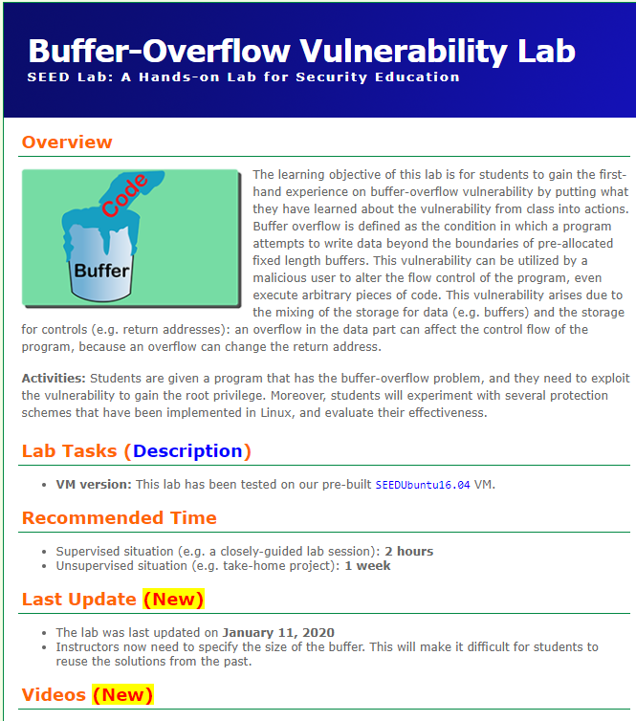
Lab1. Buffer Overflow
https://seedsecuritylabs.org/Labs_16.04/Software/Buffer_Overflow/
Learning objectives:
This lab aims to understand buffer overflow

Slide 30
Lab1. Buffer Overflow (cont.)
Task 1. Turning off countermeasures
Address Space Randomization
$ sudo sysctl -w kernel.randomize_va_space=0
The StackGuard Protection Scheme
$ gcc -fno-stack-protector example.c
Non-Executable Stack
For executable stack: $ gcc -z execstack -o test test.c
For non-executable stack: $ gcc -z noexecstack -o test test.c
Configuring /bin/sh (Ubuntu 16.04 VM only)
$ sudo ln -sf /bin/zsh /bin/sh

Slide 31
OS Security
OS Security Functions (Seperation, Memory Protection, Authentication, Authorization)
OS and Resource Protection
Trusted Operating System (MAC, DAC, Trusted Path, TCB)

Slide 32
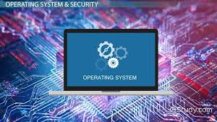
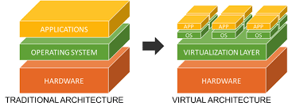
What does Operating System Security (OS Security) mean?
Operating system security (OS security) is the process of ensuring OS integrity, confidentiality and availability.
OS security encompasses many different techniques and methods which ensure safety from threats and attacks.

Slide 33
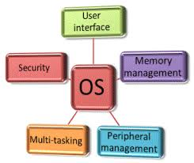
What does Operating System Security (OS Security) mean? (cont.)
OS security allows different applications and programs to perform required tasks and stop unauthorized interference.

Slide 34
What does Operating System Security (OS Security) mean? (cont.)
OS security may be approached in many ways, including adherence to the following:
Performing regular OS patch updates
Installing updated antivirus engines and software
Scrutinizing all incoming and outgoing network traffic through a firewall
Creating secure accounts with required privileges only (i.e., user management)

Slide 35

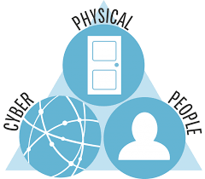
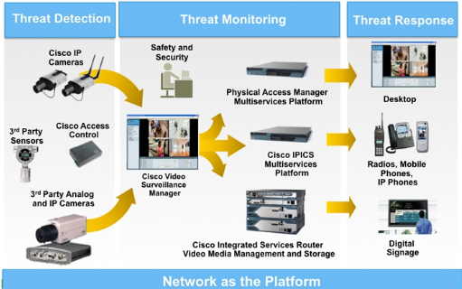
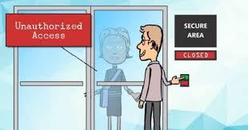
OS security issues
Physical security
Authentication
Software Vulnerabilities
Malwares
….

Slide 36
The components of an OS security environment
Used as access points to the database
Three components
Services
Files
Memory

Slide 37
Services
Main component of operating system security environment
Used to gain access to the OS and it features
Include
User authentication
Remote access
Administration tasks
Password policies

Slide 38
Files
Common threats
File permission
File sharing
Files must be protected from unauthorized reading and writing actions
Data resides in files, protecting files protects data

Slide 39
File permissions
Read, write, and execute privileges
In Windows:
Change permission on the Security tab on a file’s Properties dialog box
Allow indicates grant; Deny indicates revoke

Slide 40
Sharing Files
Naturally leads to security risks and threats
peer-to-peer programs: allow users to share files over the Internet
Reason for blocking file sharing:
Malicious code
Adware and spyware
Privacy and confidentiality
Copyright issues

Slide 41
Memory
Hardware memory available on the system can be corrupted by badly written software
Can harm data integrity
Two options:
Stop using the program
Apply a pactch (service pack) to fix it

Slide 42
Authentication
Authentication:
Verifies user identity
Permits access to the operating system
Physical authentication
Allows physical entrance to company property
Magnetic cards and biometric measures
Digital authentication: verifies user identity by digital means

Slide 43
Authorization
Process that decides whether users are permitted to perform the functions they request
Authorization is not performed until the user is authenticated
Deals with privileges and rights

Slide 44
User administration
Create user accounts
Set password policies
Grant privileges to users
Best practices:
Use a consistent naming convention
Always provide a password to an account and force the user to change it at the first logon
Protect passwords
Do not used default passwords

Slide 45
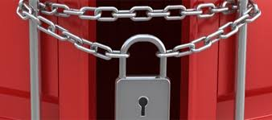
NIST approach phases
Planning
Installation
Configuration
Update
Maintenance
Consider the OS layered model, each layer needs to be properly secured, and it may be attack from layers bellow

Slide 46
OS layered model
User space
Services
System calls
Device drives
Kernel/BIOS
Instruction Set Architecture
Hardware

Slide 47
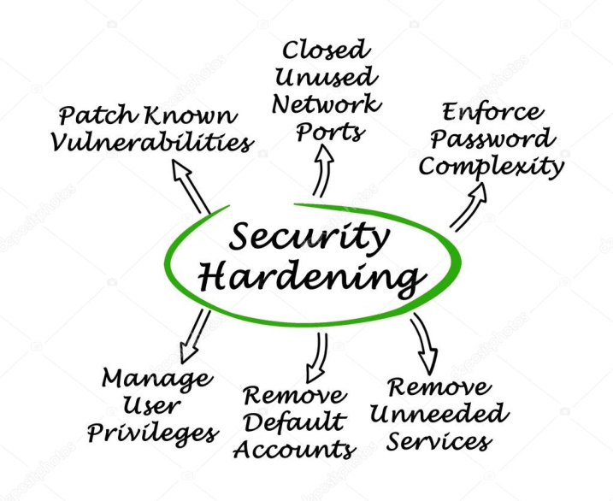
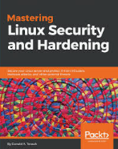
Operating Systems Hardening
Installing and pactching
Configuring
Remove unnecessary applications, services and protocols
Users, groups, controls and privileges
Install additional software (anti-virus, firewall, intrusion detection system, etc.)
Test the system security

Slide 48
Installing and patching
Installation
Machines should not connect to network until secured
Limited network (firewall) is acceptable
Install only required services and drives (from trusted sources)
Set up automatic updates (only if update time is not issue)
Booting
Protect BIOS changes with password
Disable some bootable media
Cryptographic hardware drives? Pros and Cons

Slide 49
Remove unnecessary support
Software have vulnerabilities, hence more software = more vulnerabilities
Better to not install it at all
Uninstallers sometimes fail to clean all dependency
Disable software may be enabled by an attacker upon control acquisition

Slide 50
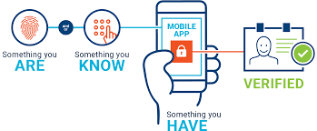
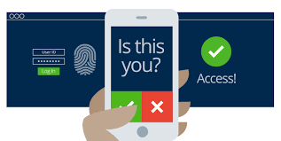
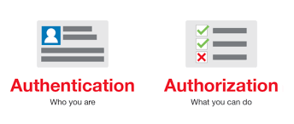
Configure authentication
Define user types and privileges
Admin (ideally only temparary)
Nornal
Limited
Authentication
Force default password change
Password definition
Password lifespan
Remove or disable old accounts
Allow for remote connections?

Slide 51
Additional security and Testing
Anti-virus
Firewall, IDS, IPS
Whitelist
If attackers manage to install a program what will happen?
Run some test cases which attempt to break security (stress testing)

Slide 52

Application Security
Configure applications properly
Use encryption when possible as seen earlier
For storing
For transmit (SSH connections)
Limit privileges as with users
Applications may provide backdoors if not configure properly

Slide 53
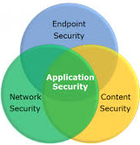
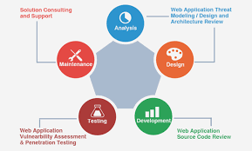
Application execution
Attackers have exploited applications through the user supplied input.
In order to mitigate this attack, a number of platforms and OSes mark the application data as non-executable so that even if the attacker manages to write data to the memory they will struggle to execute that data.

Slide 54
Maintenance
Now that system is set, keep it secure
This involves
Monitoring and analyzing logging information
Performing regular backups
Recovering from security compromises
Regular testing for security
Patch, update, and revise critical software

Slide 55
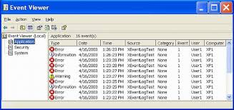
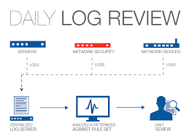
Logging
Keep a record of important events in the computer
Problems
Need to make sure to have enough space
Manual analysis is hard, so these logs should contain a format such that a program can parse messages

Slide 56
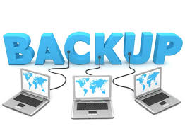
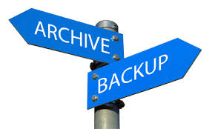
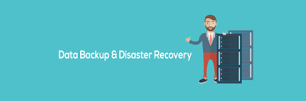
Data backup
Backup us the act of creating copies of information such that it may be recovered
Archive is to keep these backups for a long period of time in order to meed some legal aspects
Should the backup be kept online or offline?
Online makes easier access, faster recover
Offline is more secure, harder to recover
Why not both?. Users should keep their own offline backups, in case online backup gets removed
Data may be lost accidentally (hardware failures, human mistake) or intentionally

Slide 57
What should the OS protect?
Itself (from users)
Processes (both services and user’s application)
File access
Communication

Slide 58
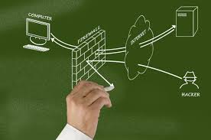
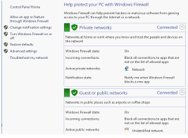
Network protection
The connectivity of operating systems to the Internet also signalled the start of a rapid increase in reported vulnerabilities.
Many Oses have built firewalls into their operating systems to reduce the ability of attackers to access network services and applications that they should not.

Slide 59


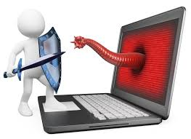
Malware protection
Malware has become an increasing issue for operating systems to deal with as users need and want to access and exchange files and applications through a variety of means, such as web portal, messaging/chat systems and social media.
Application verification and control.
Application separation - sanboxing

Slide 60
Q&A

Slide 61
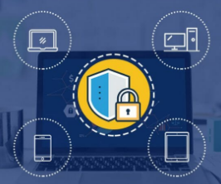
OS security audit & assessment

